Slide 1
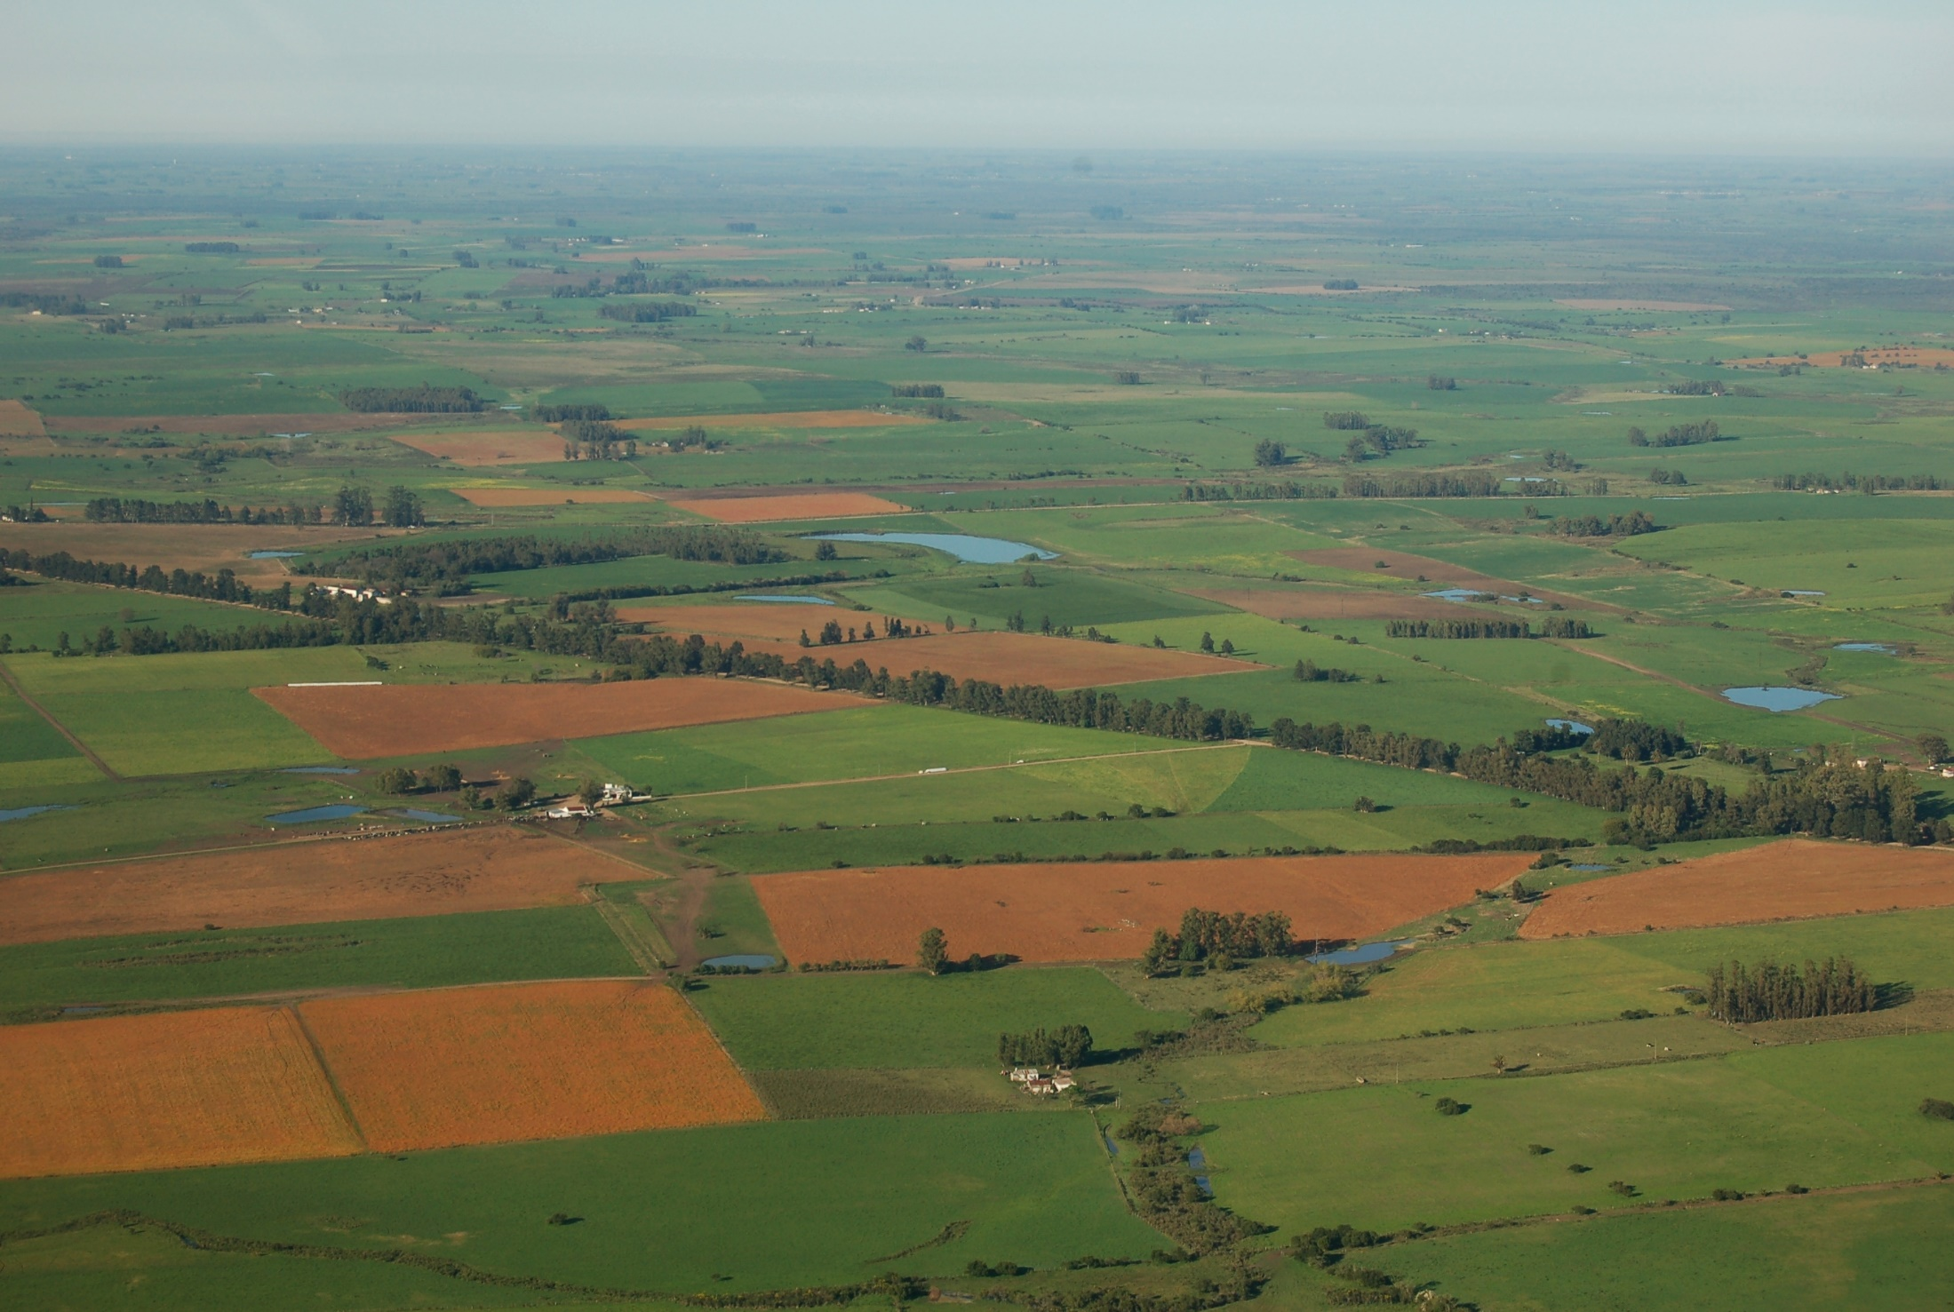
Digital Agriculture in Uruguay
OLC-KPOK KNOWLEDGE EXCHANGE
ON DIGITAL AGRICULTURE TECHNOLOGY
Seoul, 26-30 August 2019
Amalia Álvarez
Miguel Sierra
Julieta Souza

Slide 2
Agenda
Uruguayan challenges
Satellital control of Agrochemical Application
Digital Agricultural in Uruguay
Next steps
Notes:
¡Cuáles son las lecciones aprendidas que podrían ser de interés para otros países?
CONCIENCIA AGROPECUARIA DE LA IMPORTANCIA DEL AGRO
TEMAS
LICENCIA SOCIAL SE ESTÁ REDUCIENDO
GOBERNANZA, SE REQUIERA INTER E INTRA INSTITUCIONAL
INFO FUENTE DE PODER YCOMPARTIMENTACIO, Y TRABJAR SEGURIDAD DE LA INFORMACIÓN
ES CLAVE INVOLUCRAR ORGANIZACIONES Y TÉCNICOS
COLABORAR EN EL DISEÑO, GANAR Y GANAR.
CONFIAR Y RETROALIMENTAR CON LOS TÉCNICOS

Slide 3
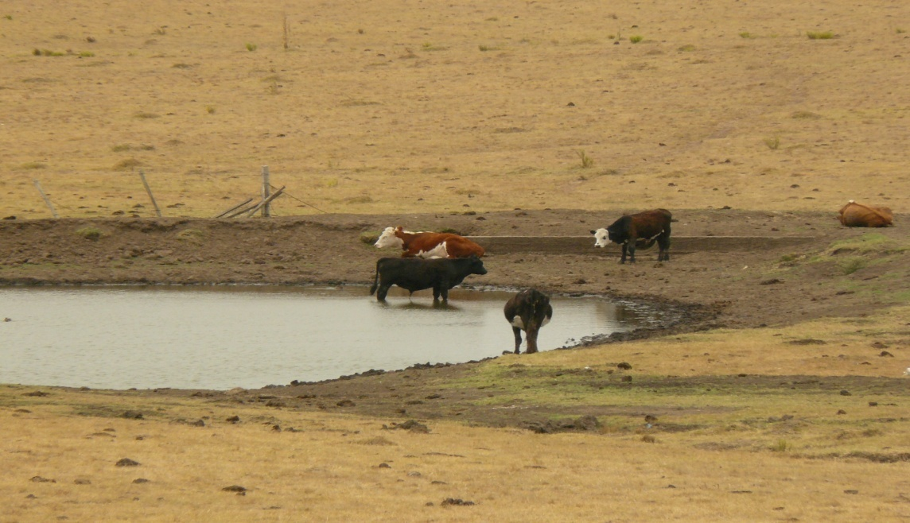
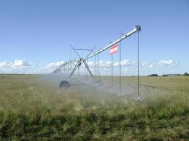
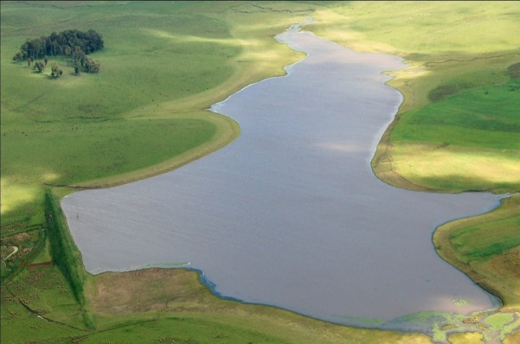
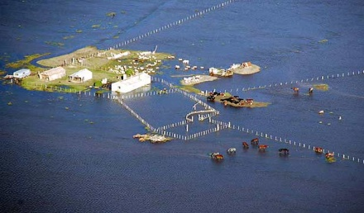
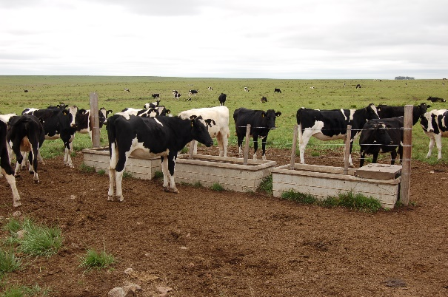
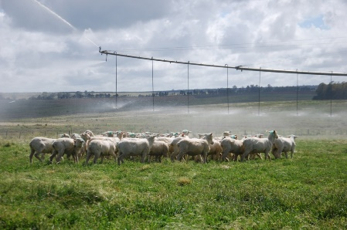
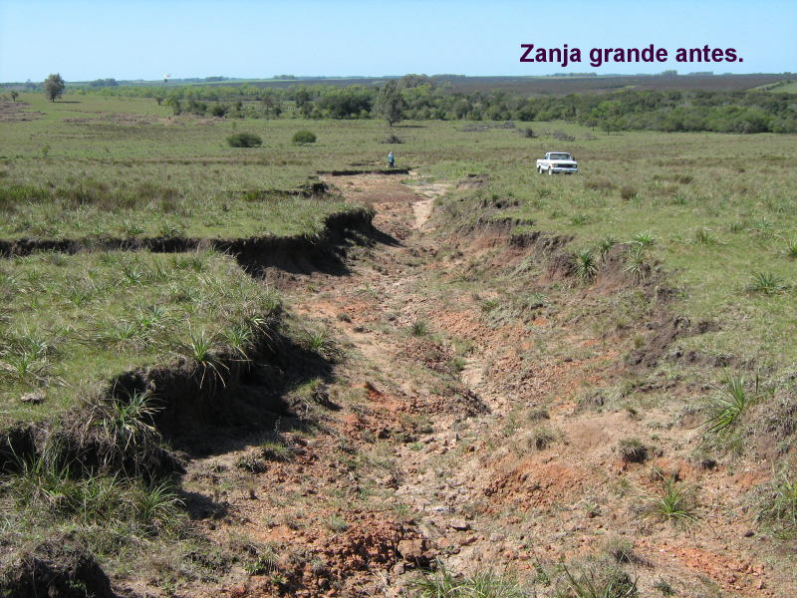
SMART AGRICULTURE
Uruguayan challenges
Sustainability
Safety Food
Protection from climate change
Efficient use of natural resources
Agri-biodiversity

Slide 4
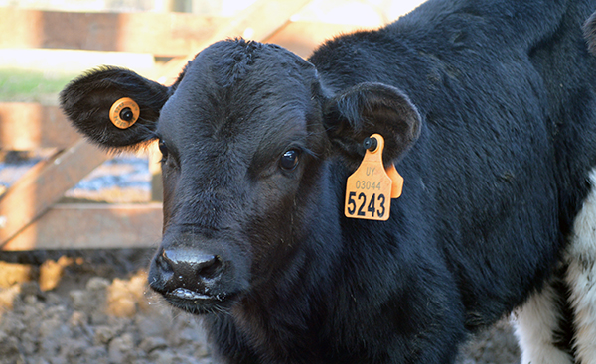
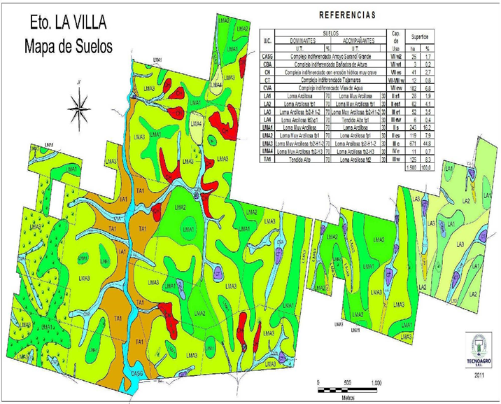
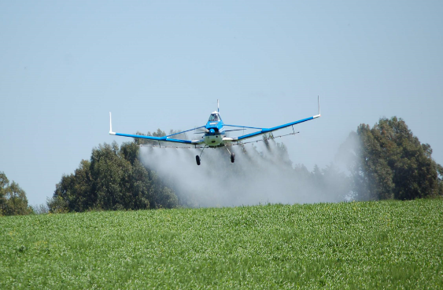
SMART AGRICULTURE
Digital Agricultural in Uruguay
Safety food
Traceability - SNIG
Soil conservation
Soil Use and Management Plans
Sustainability
Satellital control of Agrochemical Application

Slide 5
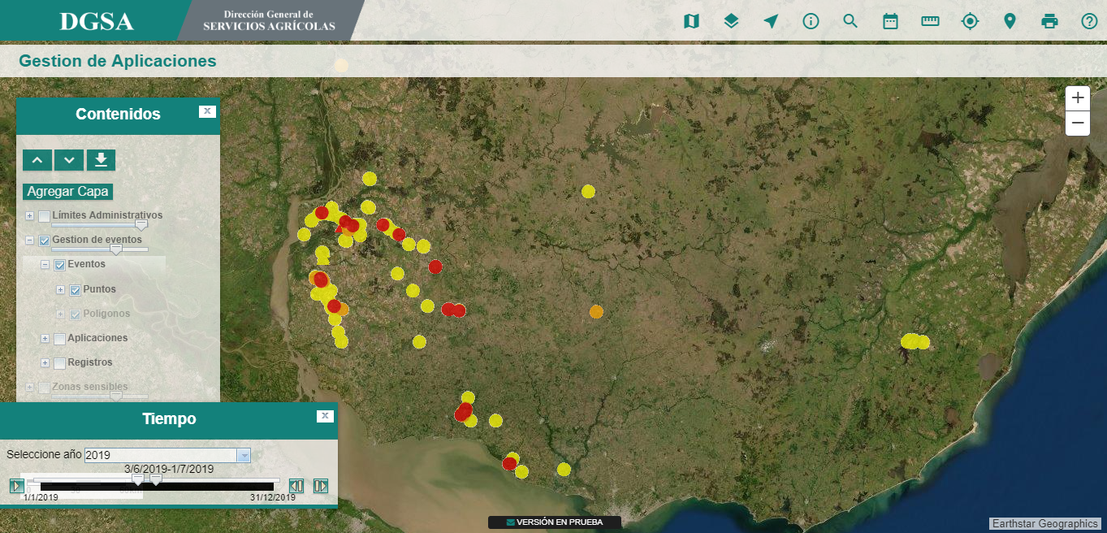
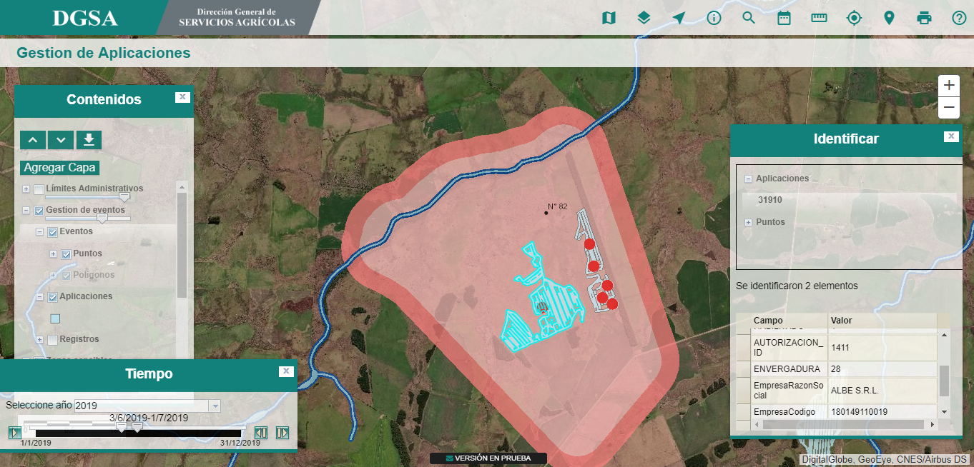
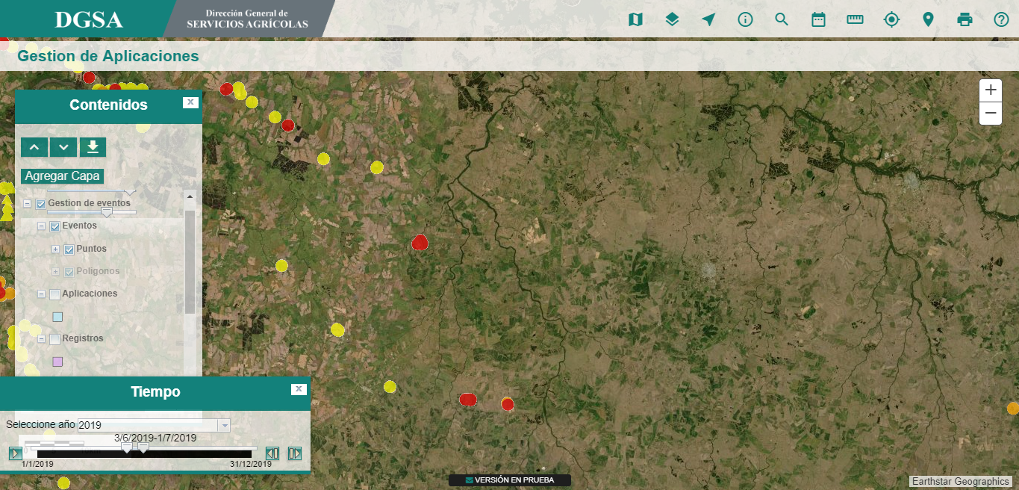
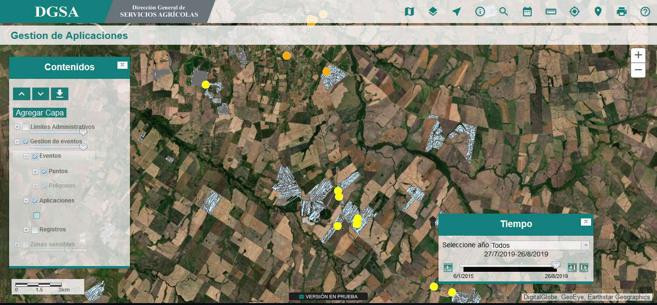
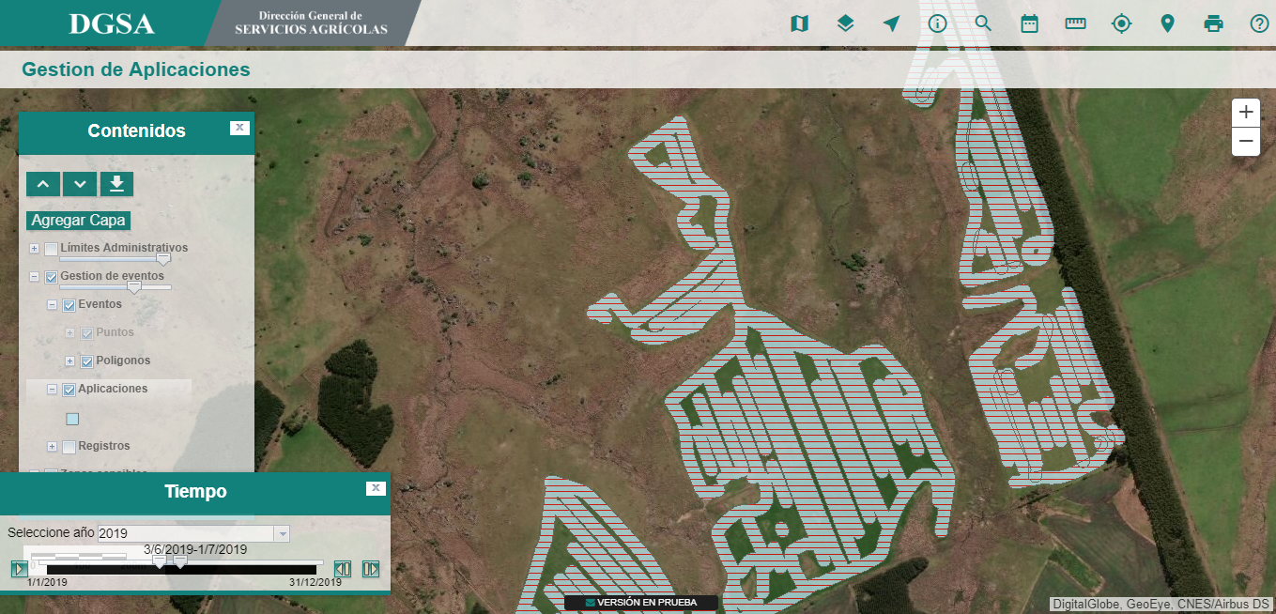
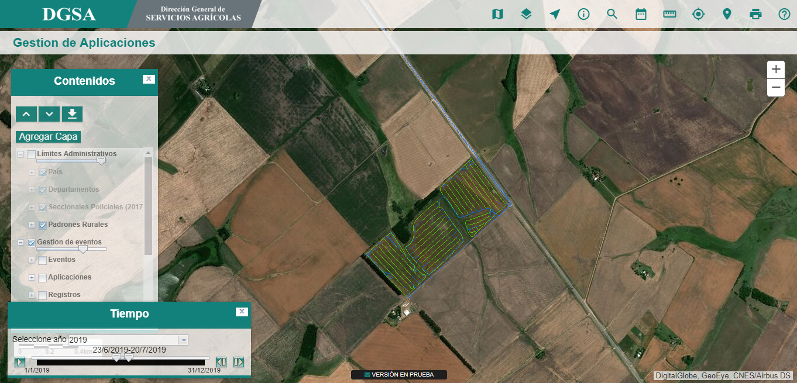
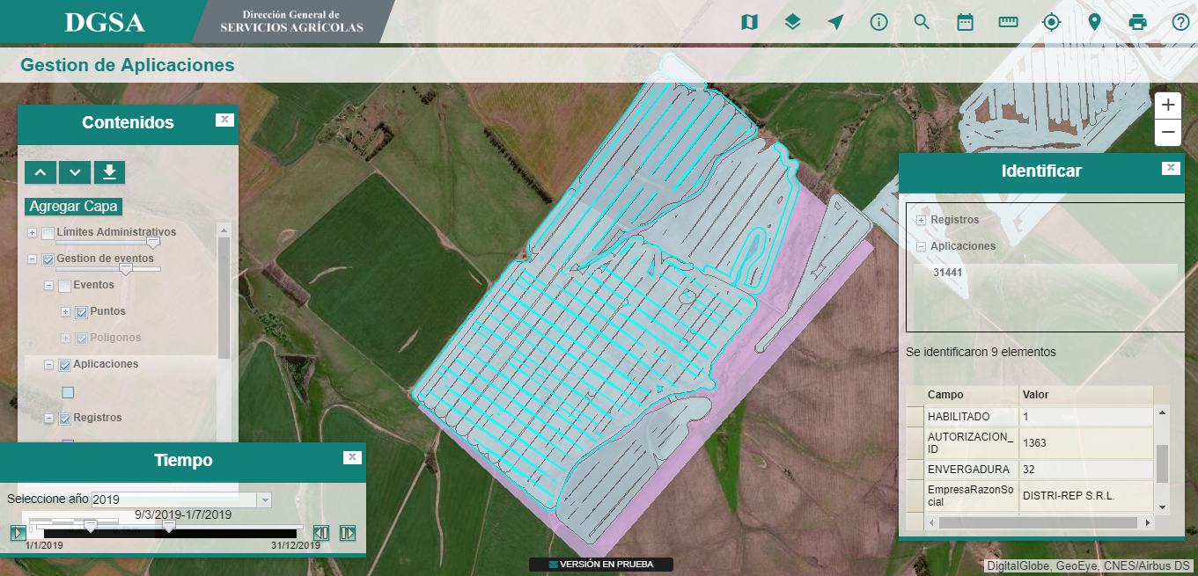
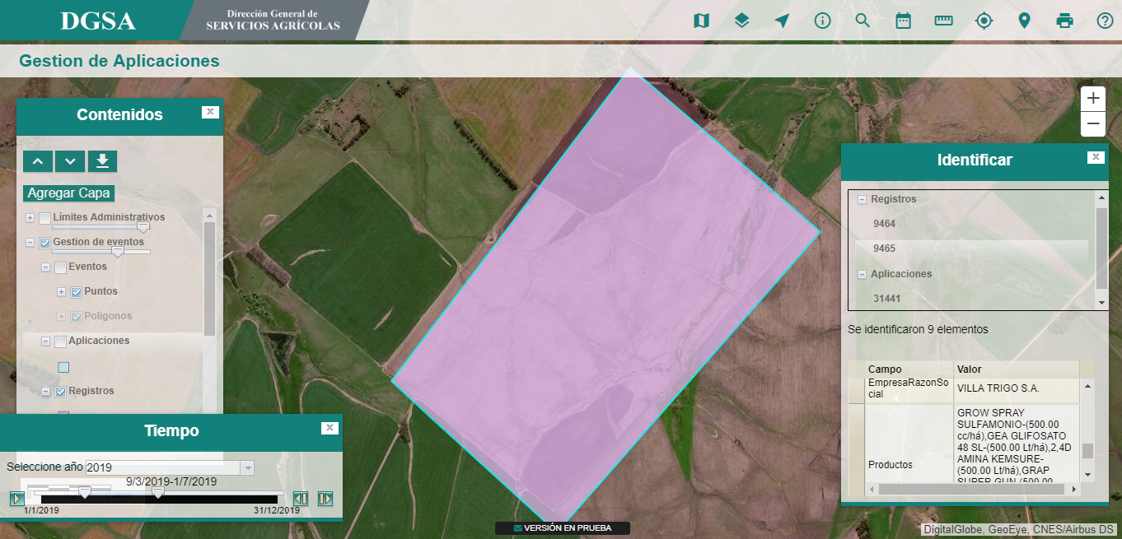
SMART AGRICULTURE
Satellital control of Agrochemical Application

Slide 6
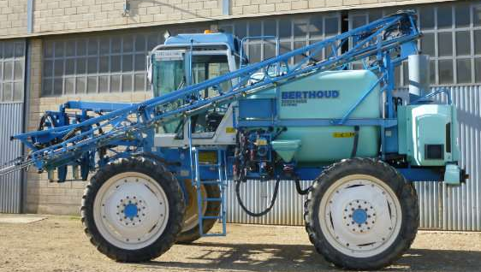
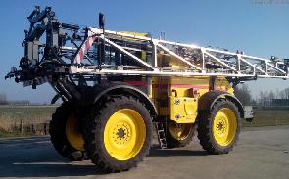
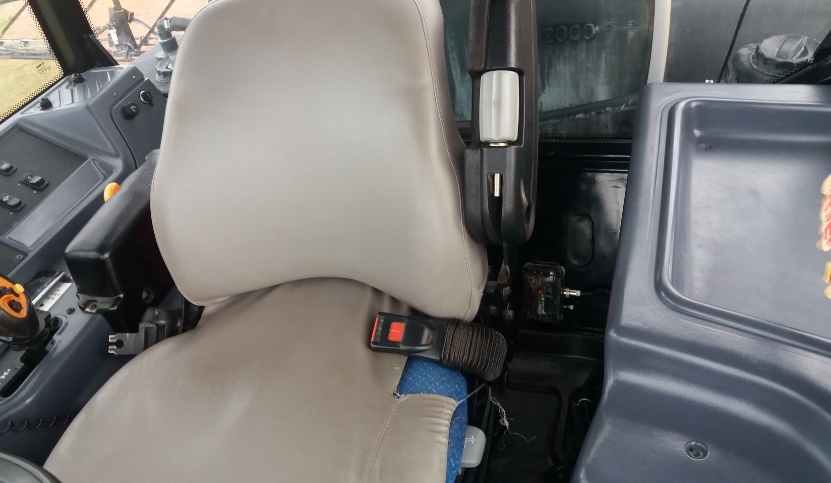
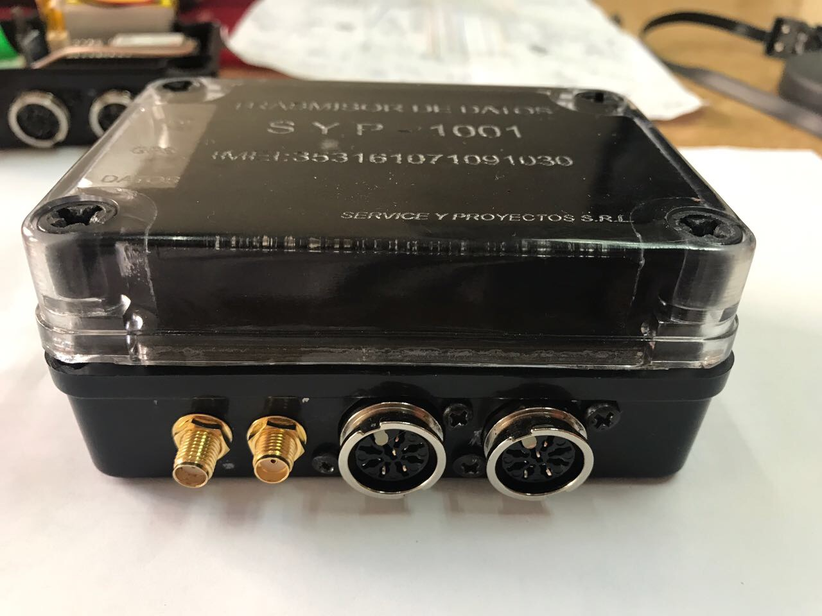
SMART AGRICULTURE
Satellital control of Agrochemical Application
Service provider
Service provider
Service provider
GPS data
Application: Yes/No
Monitor center
Feedback
Compliance Control
Registration of applications

Slide 7
SMART AGRICULTURE
Next steps
Scale nation wide
Integration with Soil Use and Management Plans
Traceability
Blockchain challenge

Slide 8
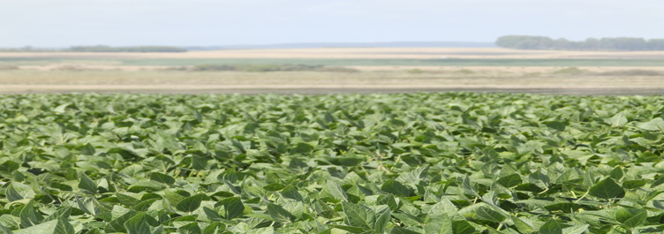
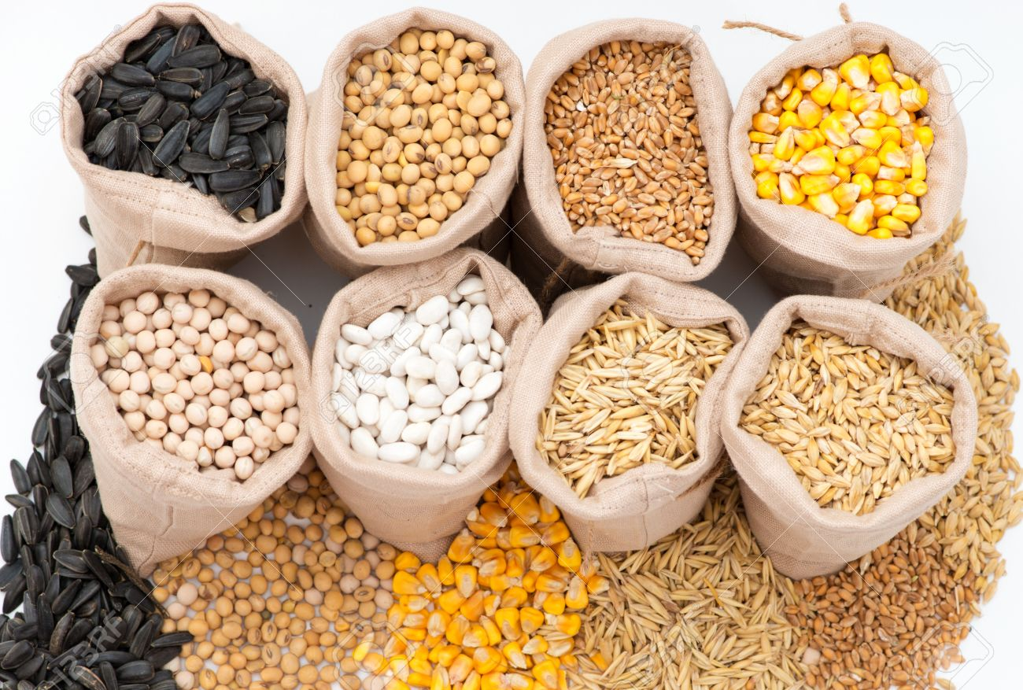
URUGUAY
AGROINTELIGENTE
Crops value chain - Traceability
Safety Food
Sustainability
Crops
Transformation
Logistics
Recolección y transporte
Sales
Crops

Slide 9
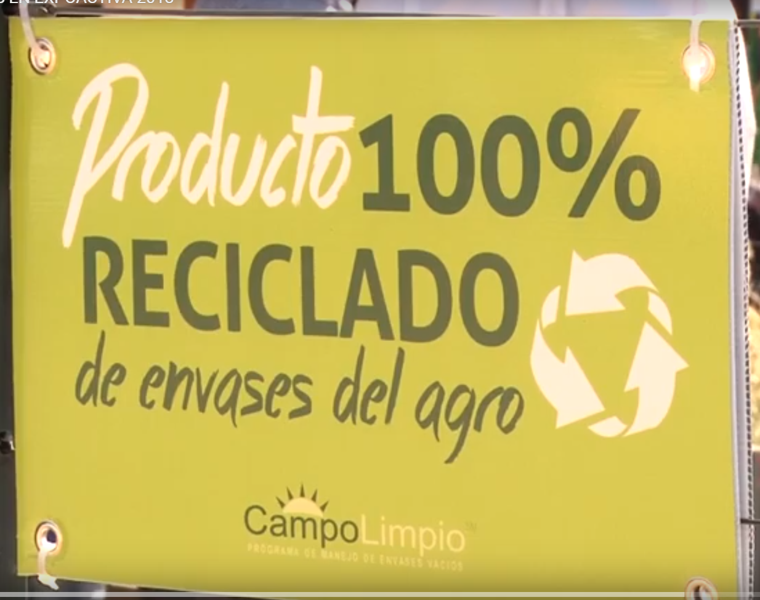
URUGUAY
AGROINTELIGENTE
Crops value chain – Traceability
Safety Food
Sustainability
Crops
Agrochemical Registration
Import / Produce
Product Application
Sale of Agrochemical
Final disposal of conteiner
Professional advice
Satellital control of Agrochemical Application

Slide 10
Thank you for your attention.
OLC-KPOK KNOWLEDGE EXCHANGE
ON DIGITAL AGRICULTURE TECHNOLOGY
Seoul, 26-30 August 2019
Amalia Álvarez
Miguel Sierra
Julieta Souza

